Slide 1
Recap: Atomic structure
You built some atoms using the PhET atom simulator and found …
1st shell has a maximum of _ electrons
*an isotope is an atom with a certain number of neutrons.

Slide 2
Recap: Atomic structure
You built some atoms using the PhET atom simulator and found …
1st shell has a maximum of 2 electrons
2nd shell has a max of _ electrons
*an isotope is an atom with a certain number of neutrons.

Slide 3
Recap: Atomic structure
You built some atoms using the PhET atom simulator and found …
1st shell has a maximum of 2 electrons
2nd shell has a max of 8 electrons
Some elements have only one stable isotope*, others have several. Examples?
*an isotope is an atom with a certain number of neutrons.

Slide 4
Recap: Atomic structure
You built some atoms using the PhET atom simulator and found …
1st shell has a maximum of 2 electrons
2nd shell has a max of 8 electrons
Some elements have only one stable isotope*, others have several. Examples?
Stable isotopes usually have a neutron:proton ratio of about 1:1, but this gets bigger for larger atomic number. Examples?
*an isotope is an atom with a certain number of neutrons.

Slide 5
Recap: Atomic structure
You built some atoms using the PhET atom simulator and found …
1st shell has a maximum of 2 electrons
2nd shell has a max of 8 electrons
Some elements have only one stable isotope*, others have several. Examples?
Stable isotopes usually have a neutron:proton ratio of about 1:1, but this gets bigger for larger atomic number. Examples?
Generally, the number of electrons equals the number of protons in the nucleus, so the atom has no net charge.
*an isotope is an atom with a certain number of neutrons.

Slide 6
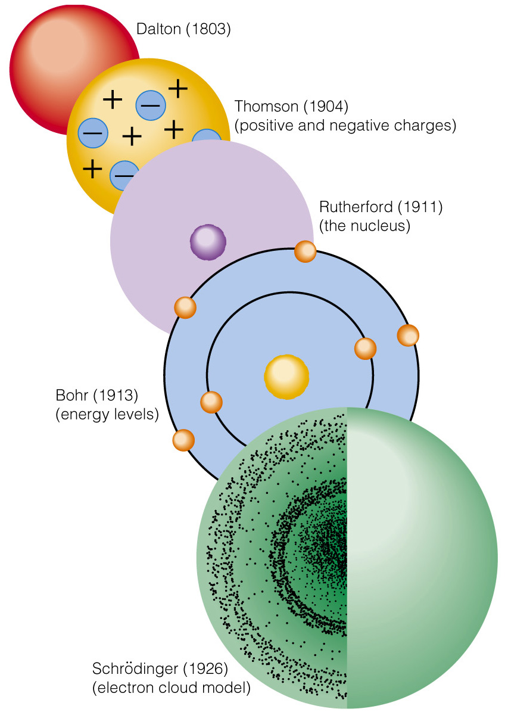
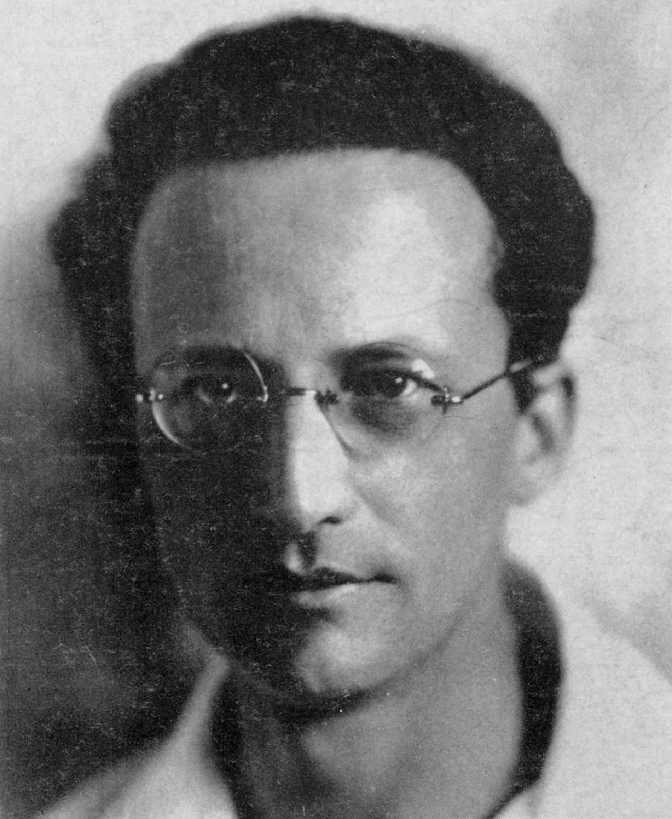
Recap: Atomic structure
Erwin Schrödinger
The cloud of negative charge around the nucleus is really made of fast-moving particles called electrons.
Electrons have the exact opposite charge to that of protons (-1), but their mass is much smaller (about 1/2000).
The electron cloud is layered to make shells. The radius of the outermost shell (also called the valence shell) is more or less responsible for the size of the atom.
Looks like there are three shells here

Slide 7
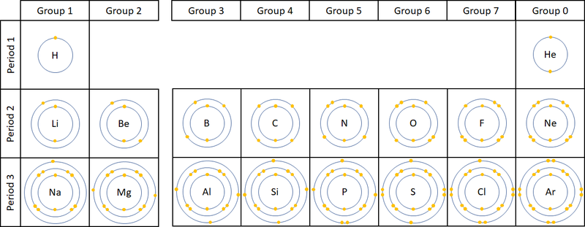
Big connection between atomic structure and the Periodic Table
Rows of the periodic table correspond to the number of shells with electrons in them

Slide 8
Big connection between atomic structure and the Periodic Table
Electrons in the 1st shell only
Electrons in the 1st and 2nd shell
Electrons in shells 1-3

Slide 9
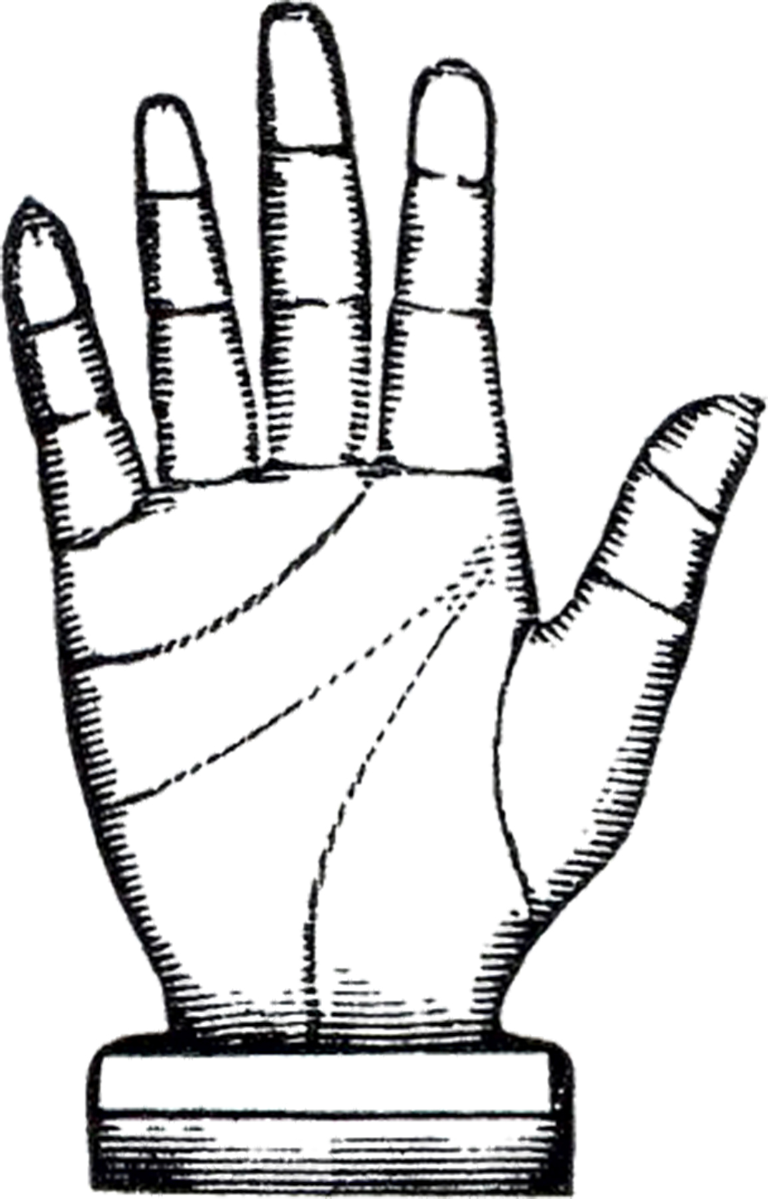
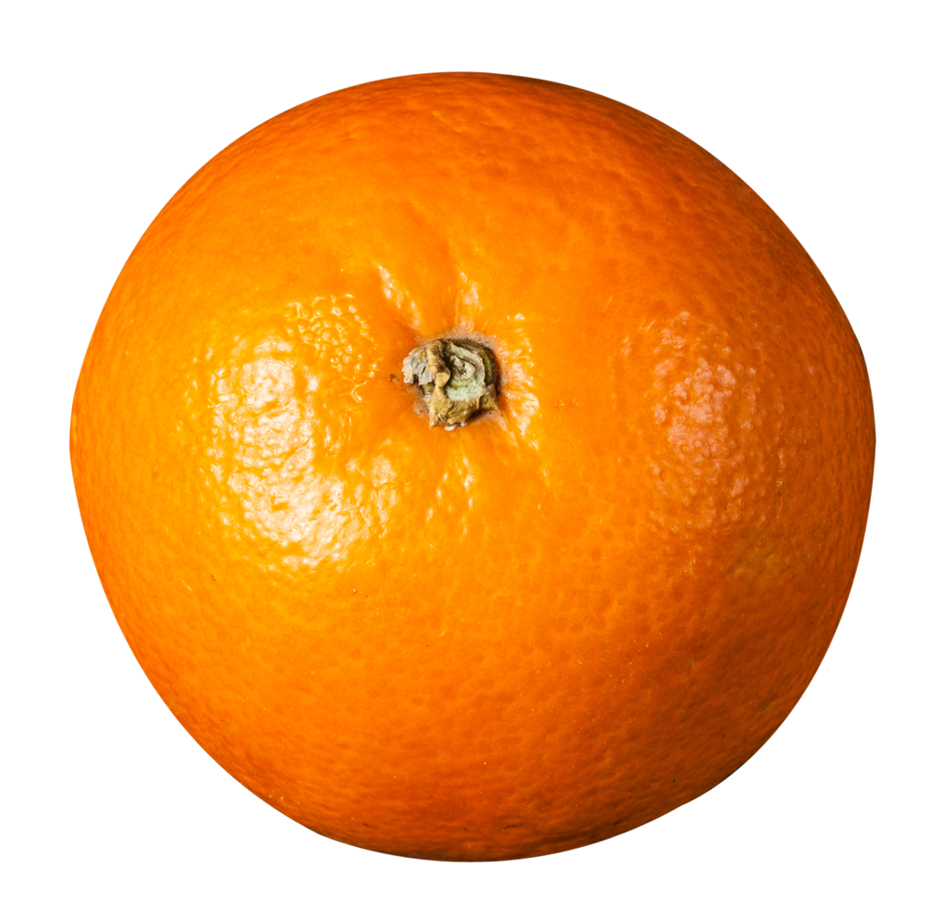

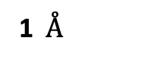
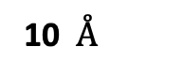
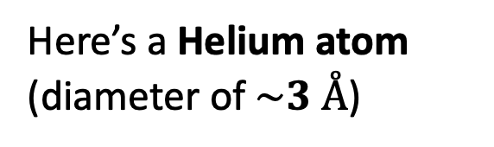
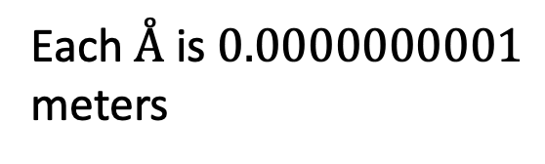
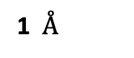
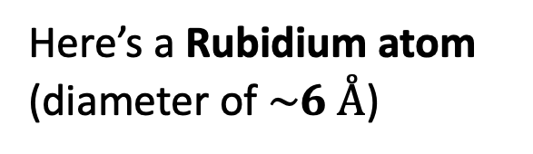
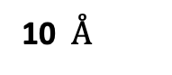
The size of atoms: Å scale
Here’s a Helium atom (diameter of $\sim 3 Å$)
Here’s a Rubidium atom (diameter of $\sim 6 Å$)
10 $Å$
10 $Å$
1 $Å$
1 $Å$
Each $Å$ is $0.0000000001$ meters

Slide 10
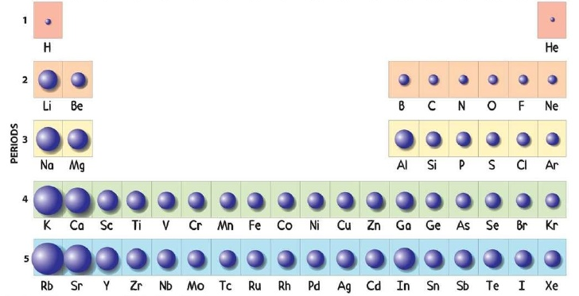
The size of atoms: Trends across the Periodic Table
Atoms are bigger as you go down and to the left in the periodic table (mostly).
The up-down trend is due to electrons occupying bigger shells

Slide 11
The size of atoms: Trends across the Periodic Table
Atoms are bigger as you go down and to the left in the periodic table (mostly).
What do you suppose is responsible for the right-left trend?

Slide 12
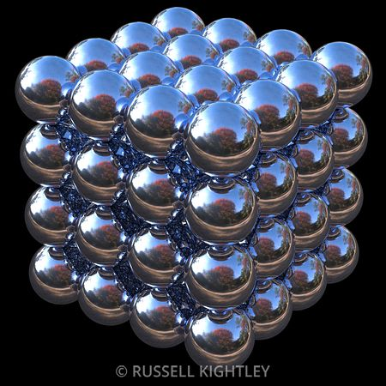
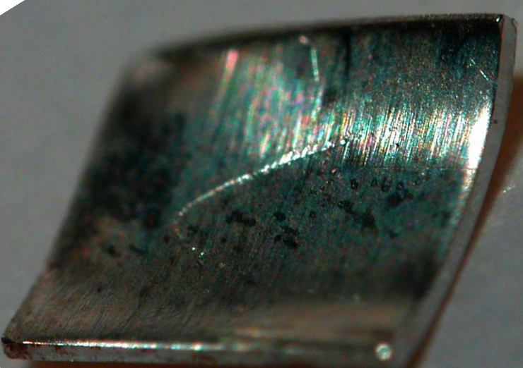
The size of atoms: how do we know how big atoms are?
If we measure the size of a sample, and then estimate number of atoms across, we can use that to back out the size of a single atom!
Polonium (Po)

Slide 13
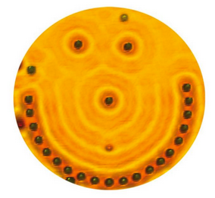
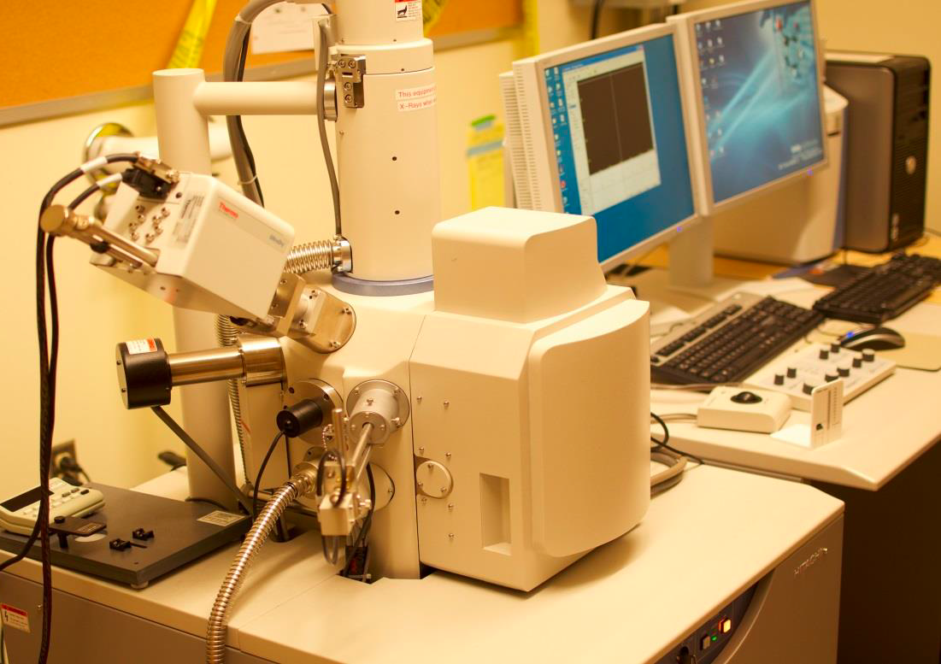
The size of atoms: how do we know how big atoms are?
Silver (Ag) atoms
A scanning electron microscope (SEM) allows us to “see” individual atoms
SEM in the basement of Thompson/Harned

Slide 14
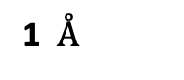
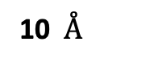
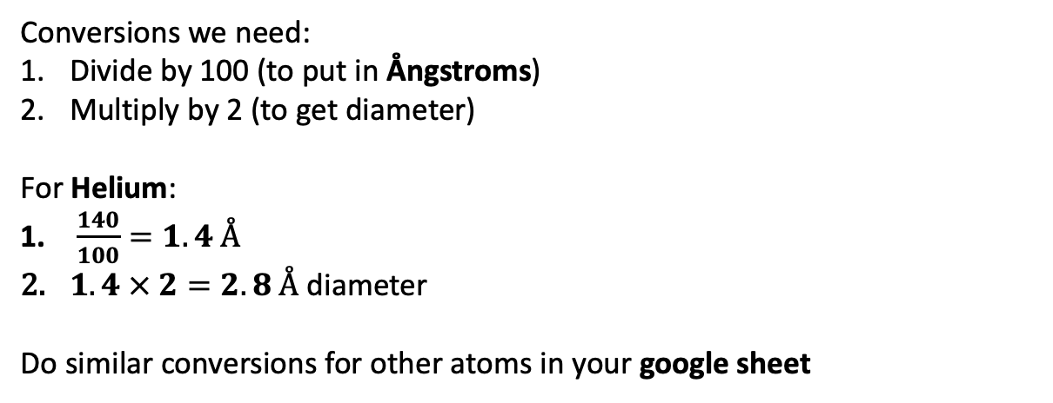
Atomic size conversions
Radii have been compiled at https://en.wikipedia.org/wiki/Van_der_Waals_radius
10 $Å$
1 $Å$
Conversions we need:
Divide by 100 (to put in Ångstroms)
Multiply by 2 (to get diameter)
For Helium:
$\frac{140}{100}=1.4 Å$
$1.4 × 2=2.8 Å$ diameter
Do similar conversions for other atoms in your google sheet

Slide 15


The stickiness of atoms and covalent molecules
So, atoms are slightly sticky. What does that mean? Two things are sticky if it costs energy to pull them apart.

Slide 16
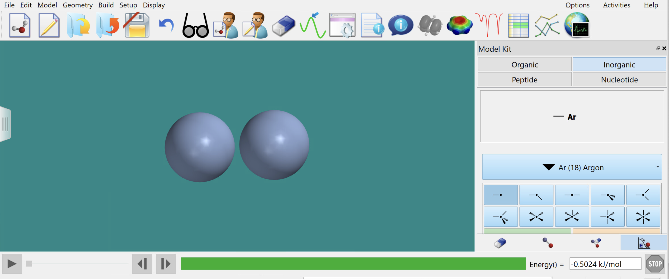
The stickiness of atoms and covalent molecules
So, atoms are slightly sticky. What does that mean? Two things are sticky if it costs energy to pull them apart.
3.7 Å
Energy =-0.5 kJ/mol

Slide 17
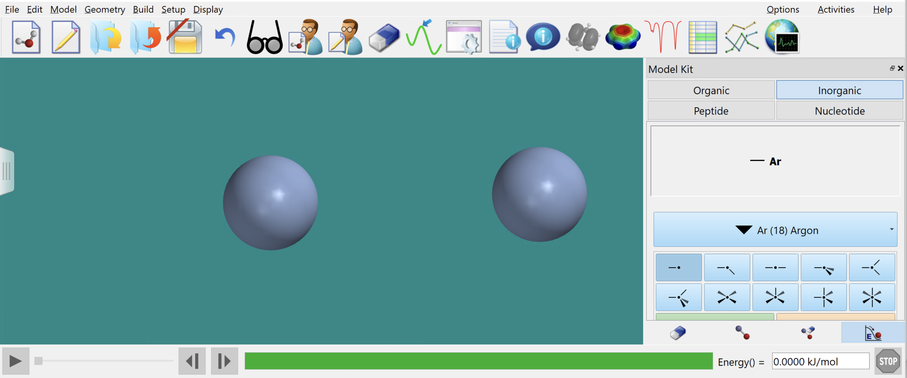
The stickiness of atoms and covalent molecules
So, atoms are slightly sticky. What does that mean? Two things are sticky if it costs energy to pull them apart.
10 Å
Energy = 0.0 kJ/mol

Slide 18
The stickiness of atoms and covalent molecules
So, atoms are slightly sticky. What does that mean? Two things are sticky if it costs energy to pull them apart.
10 Å
Energy = 0.0 kJ/mol
So … the atoms are bound to each other with an energy of 0.5 kJ/mol

Slide 19
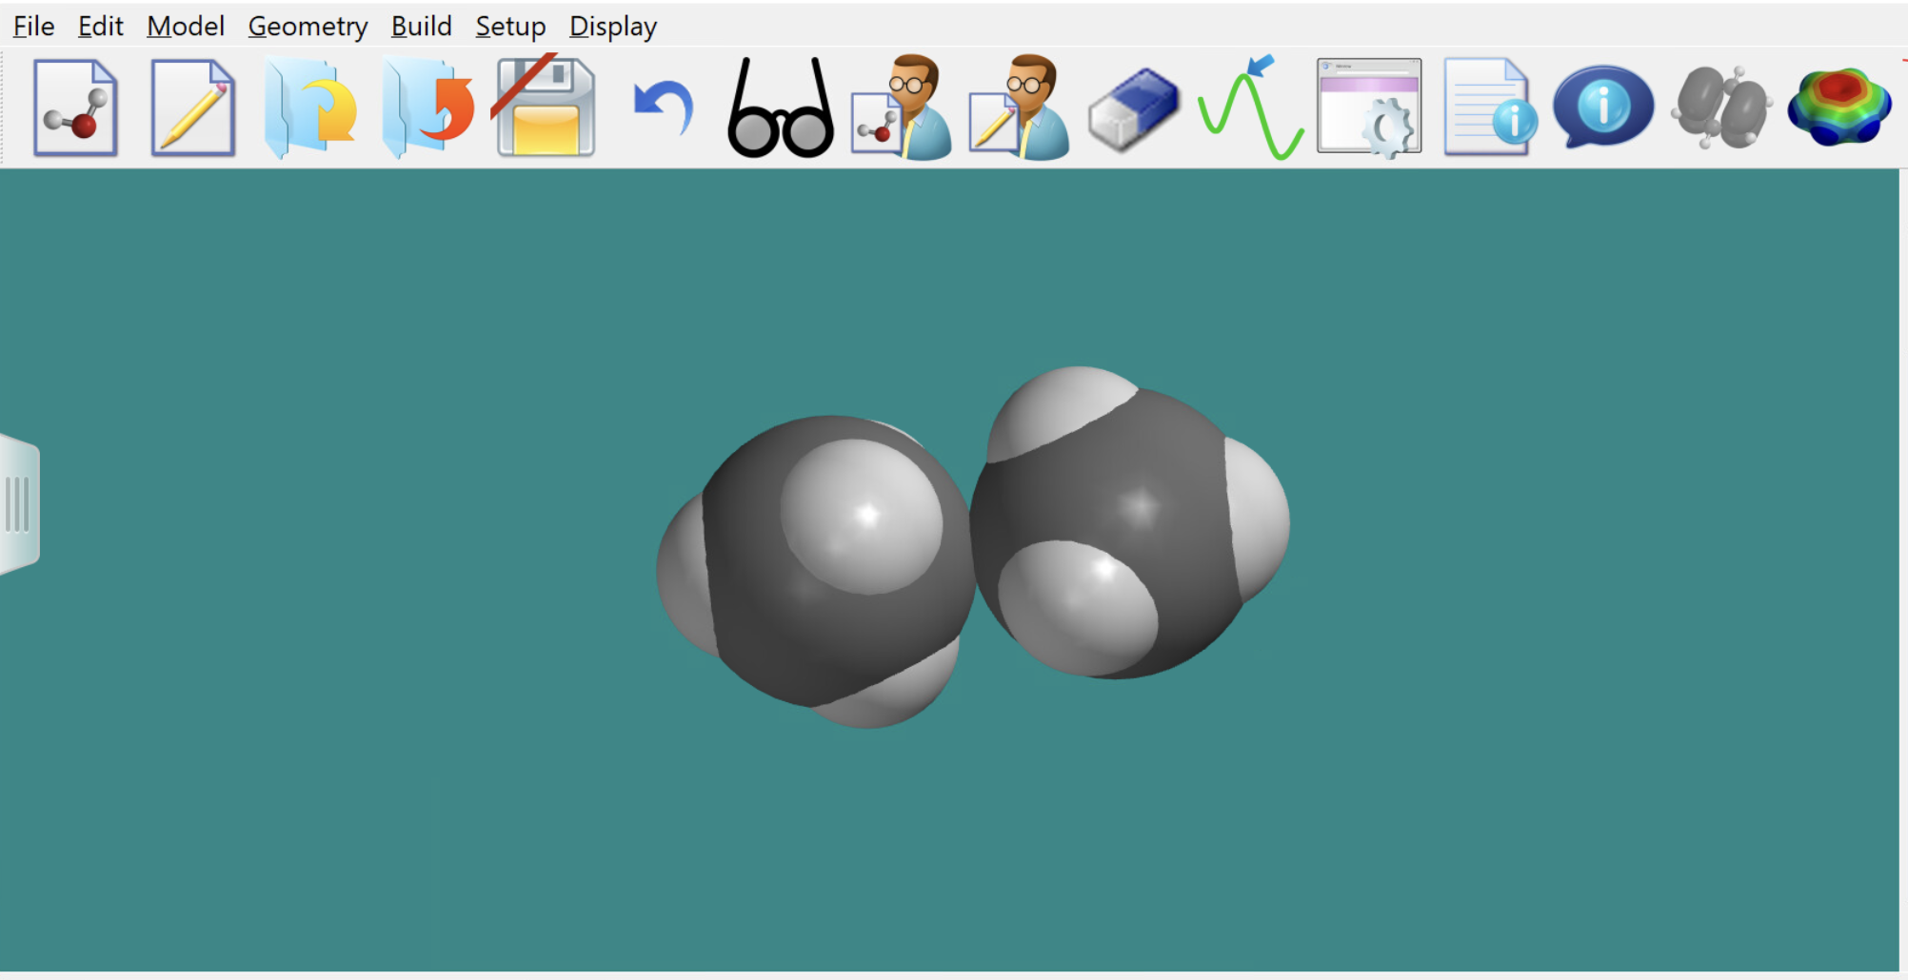
The stickiness of atoms and covalent molecules
What’s the binding energy of these two molecules?

Slide 20
What we’ll do in (virtual) lab today …
Decide on teams, and split into break-out groups to explore the concept of stickiness
Learn how to cut and paste into a google slide document
Prepare presentations

